Slide 1

Deep Dive into NLP based Classification and 3X Interpretation
Tech Talks – 10-Nov-21
- Arka Prava Bandyopadhyay

Slide 2
Agenda
Introduction
Machine Learning Based Methods
Pre-processing
Text Clean-up
Remove Stop words
Remove all punctuations.
Text Transformation
Count Vectorizer (Bag of words)
TF-IDF
Machine Learning Based Models for Classification:
Random Forest Classifier
SVM
Naive Bayes
Logistic Regression
XGBoost
Model Explanations
Using Inbuilt Feature Importance
Using Lime
Using Shap
Deep Learning Based Methods:
No Pre-processing
Create a Classification Model Using Bert
Bert Model Explanations - Using Inbuilt Feature Importance, Shap and Lime
Comparing Models
Using Accuracy
Comparing Model Explanations using Jaccard Similarity

Slide 3
Introduction
Context
- Justice delayed is justice denied.
- Getting Justice is a time consuming process.
- Can we use AI/ machine learning technique to provide instant justice by predicting outcome of the filed cases.
Objective
- To predict the outcome of a case using different Machine learning and Deep Learning Methods - 20
- Interpret / Explain and compare the results - 80
Data
Legal cases filed (in Dutch) in Netherlands, from 1995 to 2010.
Set 1 :
16597 Cases with the outcomes(0:44%, 1:56%)
Set 2 :
8180 curated cases(0:43%, 1:57%).

Slide 4
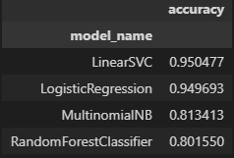
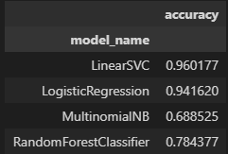
Accuracy Comparison
Set 1 :
Count Vectorizer :
TF-IDF Vectorizer :
Set 2 :

